Slide 1
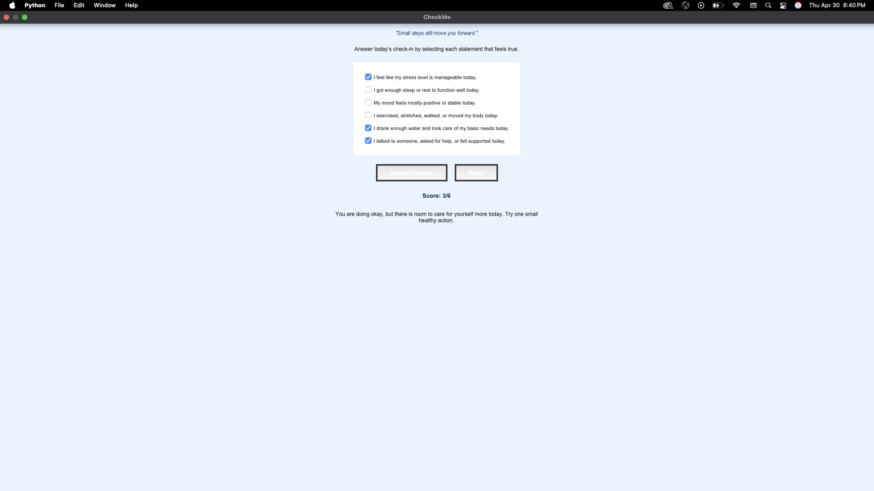
CheckMe – Smart Mental Health Tracker
Check your mind. Track your life. Level up your mental health.
• Daily mental health check-in
• Tracks stress, sleep, mood, and habits
• Instant feedback and scoring system
• Helps build awareness and better routines
Team Member: J.C. Powers

